Slide 1
Applied Machine Learning
Revision
Anita Ramachandran

Slide 2
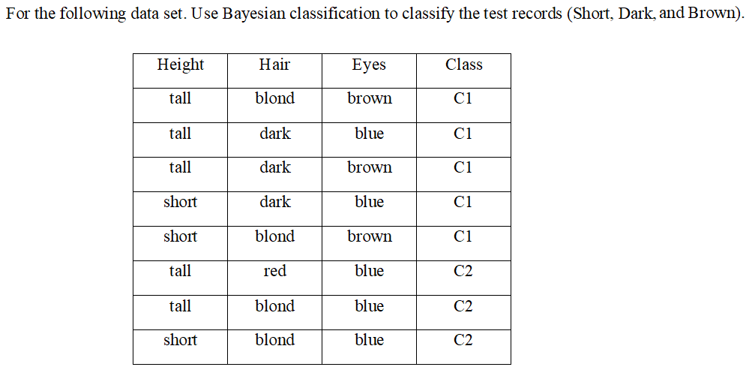
Question 1

Slide 3
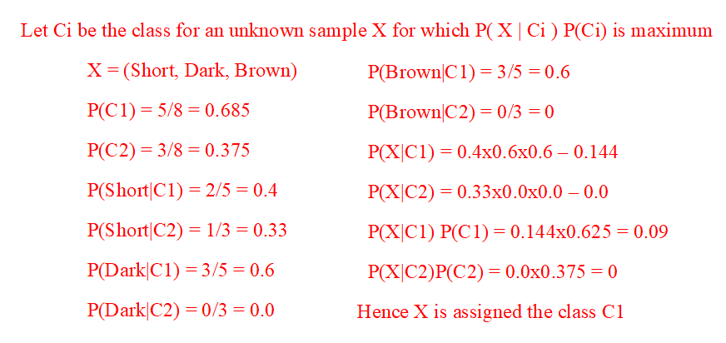
Solution 1

Slide 4
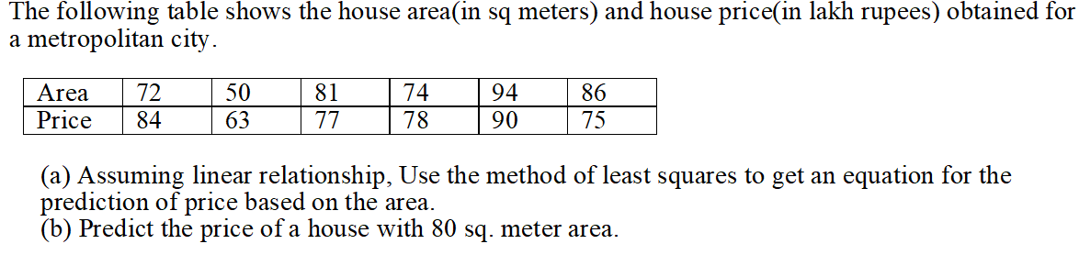
Question 2

Slide 5
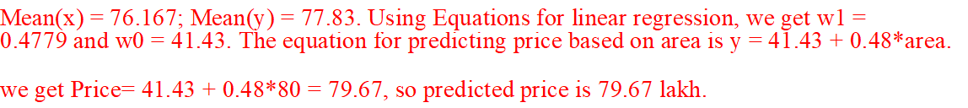
Solution 2

Slide 6
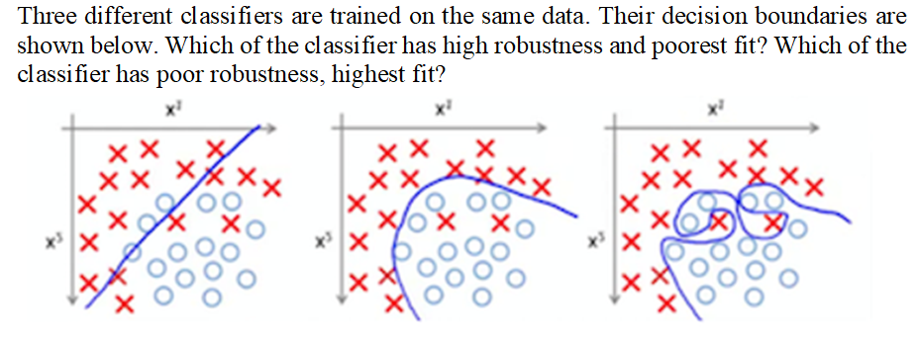
Question 3

Slide 7
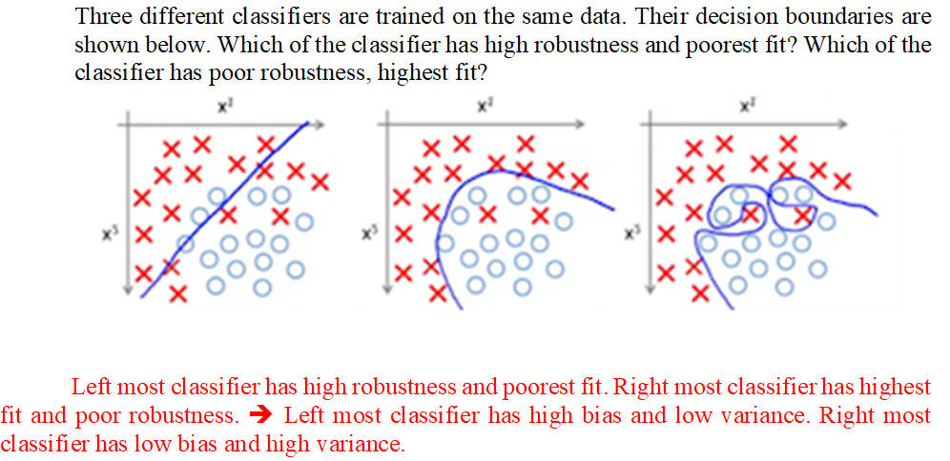
Solution 3

Slide 8
Question 4
Vijay is a certified Data Scientist and he has applied for two companies -Google and Microsoft. He feels that he has a 60% chance of receiving an offer from Google and 50% chance of receiving an offer from Microsoft. If he receives an offer from Microsoft, he has belief that there are 80% chances of receiving an offer Google.
If Vijay receives an offer from Microsoft, what is the probability that he will not receive an offer from Google?
What are his chances of getting an offer from Microsoft, considering he has an offer from Google?
Notes:
P(G) = 0.6
P(M) = 0.5
P(G|M) = 0.8
P(M|G) = P(G|M) x P(M) / P(G) = 0.8 x 0.5 / 0.6

Slide 9
Solution 4
Vijay is a certified Data Scientist and he has applied for two companies -Google and Microsoft. He feels that he has a 60% chance of receiving an offer from Google and 50% chance of receiving an offer from Microsoft. If he receives an offer from Microsoft, he has belief that there are 80% chances of receiving an offer Google.
If Vijay receives an offer from Microsoft, what is the probability that he will not receive an offer from Google?
What are his chances of getting an offer from Microsoft, considering he has an offer from Google?
Ans
P(not g| m) = 0.2
P(M|G)=0.67

Slide 10
Question 5
Solve the below and find the equation for hyper plane using linear Support Vector Machine method. Positive Points: {(3, 2), (4, 3), (2, 3), (3, -1)} Negative Points: {(1, 0), (1, -1), (0, 2), (-1, 2)}

Slide 11
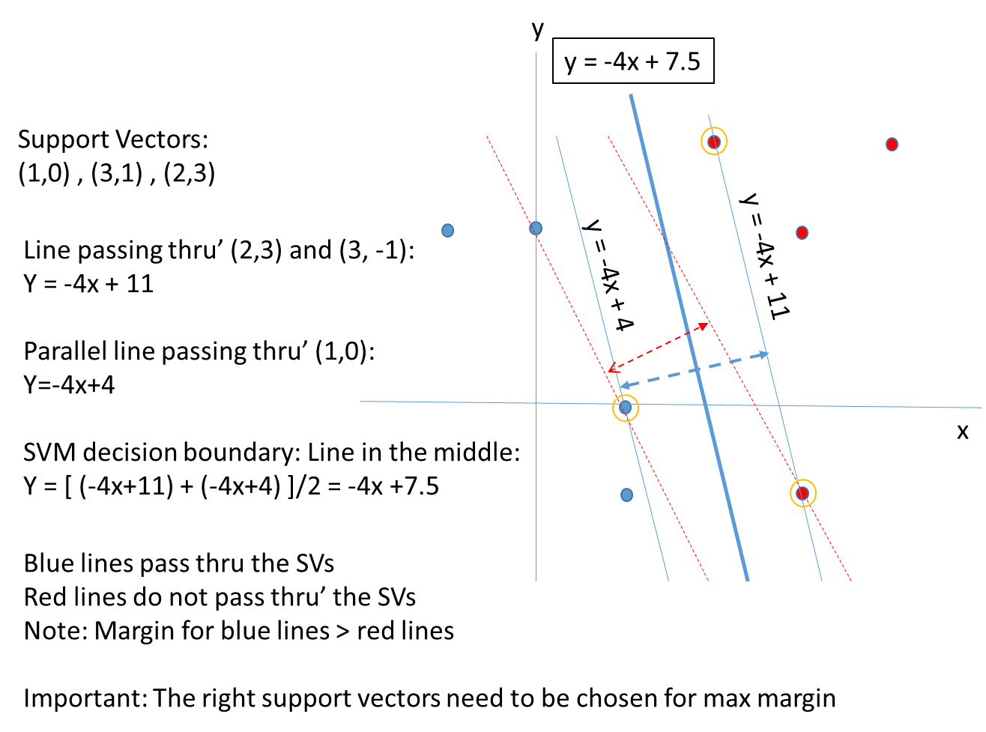
Solution 5
Solve the below and find the equation for hyper plane using linear Support Vector Machine method.
Positive Points: {(3, 2), (4, 3), (2, 3), (3, -1)}
Negative Points: {(1, 0), (1, -1), (0, 2), (-1, 2)}

Slide 12
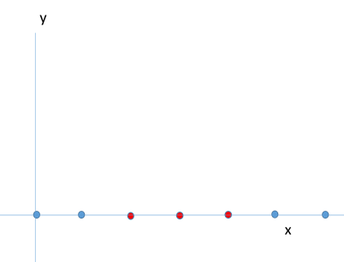
Question 6
Use kernel trick and find the equation for hyper plane using nonlinear SVM. Positive Points: {(2,0), (3,0), (4,0)} Negative Points: {(0,0), (1,0), (5,0), (6,0)}

Slide 13
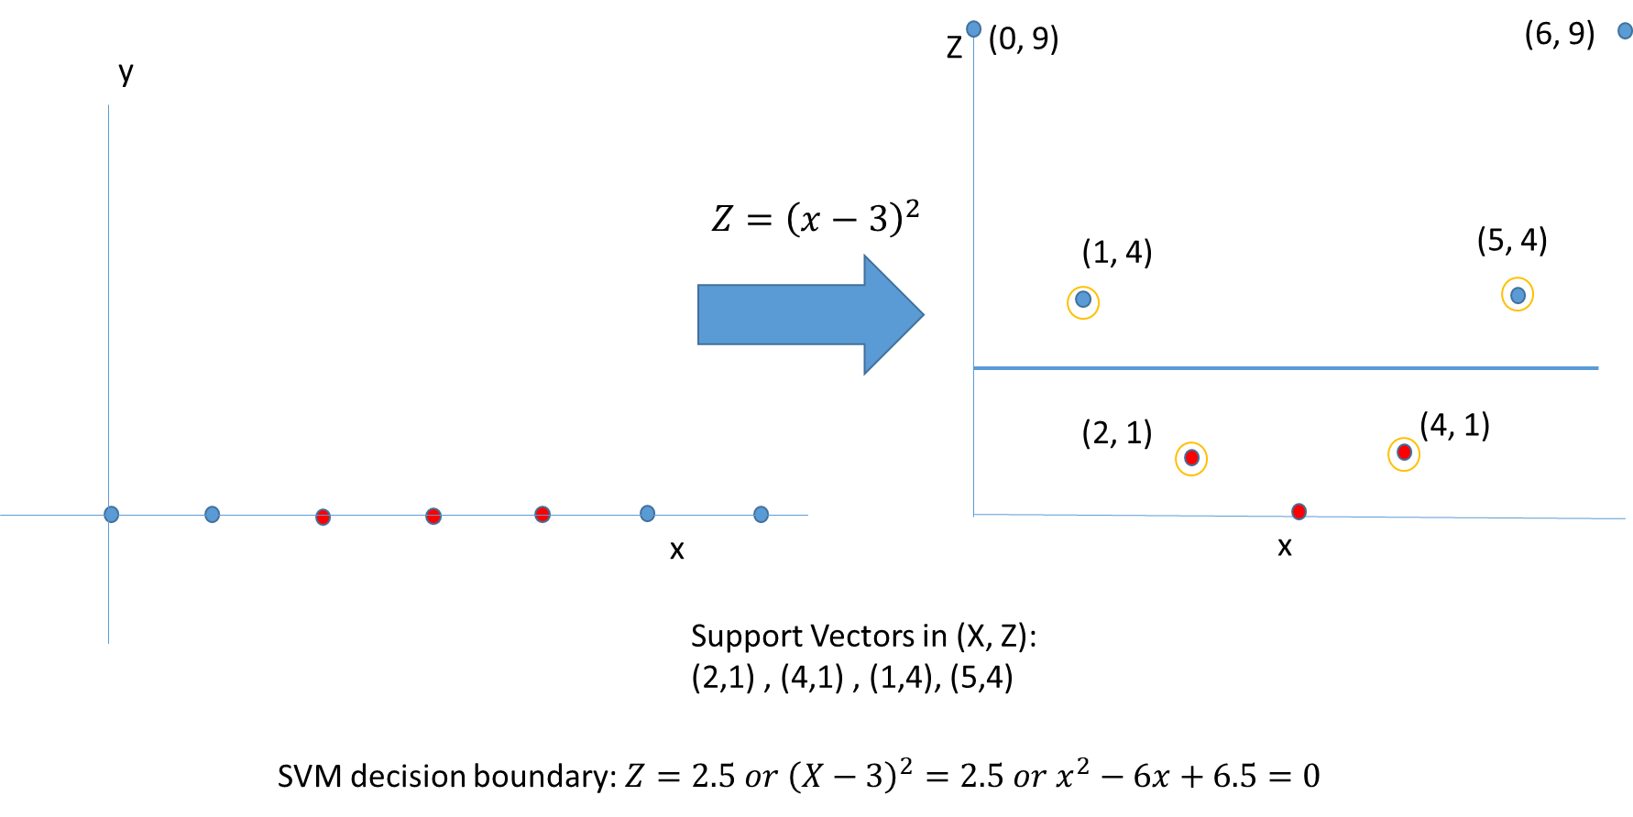
Solution 6
Use kernel trick and find the equation for hyper plane using nonlinear SVM. Positive Points: {(2,0), (3,0), (4,0)} Negative Points: {(0,0), (1,0), (5,0), (6,0)}

Slide 14
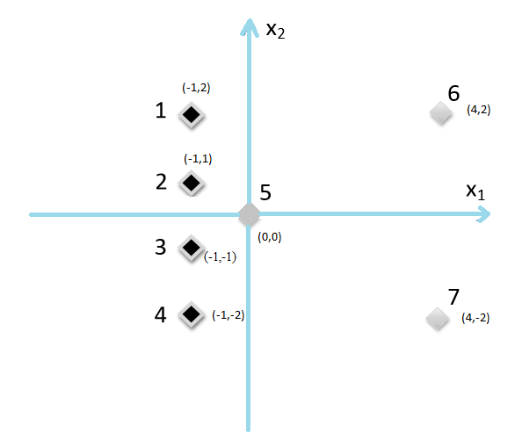
Question 7
Consider a 2-class classification problem in a 2 dimensional feature space x=[x1, x2] with target variable y=±1.The training data comprises 7 samples as shown below. 4 black diamonds for the positive class and 3 gray diamonds for the negative class.
  Find the k-means cluster centers for the two (black diamond and gray diamonds) classes.
  What is the equation for linear decision boundary which is equidistant from the two cluster center?
  What is the training error rate?

Slide 15
Solution 7
Consider a 2-class classification problem in a 2 dimensional feature space x=[x1, x2] with target variable y=±1.The training data comprises 7 samples as shown below. 4 black diamonds for the positive class and 3 gray diamonds for the negative class.
  Find the k-means cluster centers for the two (black diamond and gray diamonds) classes.
    Black diamond class: (-1.0,0.0)
    Gray diamond class: (8/3, 0.0)
  What is the equation for linear decision boundary which is equidistant from the two cluster center?
    x1=(8/3-1)/2=5/6
  What is the training error rate?
    1/7 (gray diamond point at (0,0) will be misclassified)

Slide 16
Question 8
Using K-means Clustering algorithm, create 4 clusters for the following dataset.
(2, 5), (2.5, 3), (3.5, 4), (5, 7.9), (8, 11.3), (11, 12), (12, 19), (13, 5), (7, 3), (11, 7), (15,15.1), (1, 2), (2, 20), (10, 10), (13, 1.1), (7, 9), (30, 42), (18, 21), (55, 39), (32, 68), (30,30), (50, 50.1)
Choose 4 random initial cluster centers as C1 = (2, 5), C2 = (11, 12), C3 = (18, 21), and C4 = (30, 30)
Calculate the distance by using the Distance Function between two points a = (x1, y1) and b = (x2, y2) as follows: P(a,b)=|x2–x1|+|y2–y1|

Slide 17
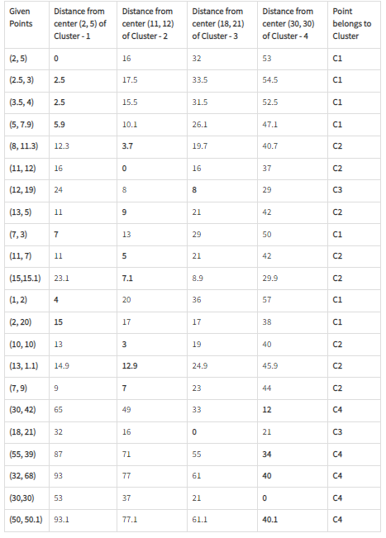
Solution 8 - Iteration 1
Now, re-compute the new centers of 4 clusters. The new cluster center is computed by taking the mean of all the data points contained in that cluster.
For Center of Cluster - 1
X = (2 + 2.5 + 3.5 + 5 + 7 + 1 + 2) / 7 = 3.28
Y = (5 + 3 + 4 + 7.9 + 3 + 2 + 20) / 7 = 6.414
Therefore, C1 = (3.28, 6.414)
For Center of Cluster - 2
X = (8 + 11 + 13 + 11 + 15 + 10 + 13 + 7) / 8 = 11
Y = (11.3 + 12 + 5 + 7 + 15.1 + 10 + 1.1 + 9) / 8 = 8.8125
Therefore, C2 = (11, 8.8125)
For Center of Cluster - 3
X = (12 + 18) / 2 = 15
Y = (19 + 21) / 2 = 20
Therefore, C3 = (15, 20)
For Center of Cluster - 4
X = (30 + 55 + 32 +30 + 50) / 5 = 39.4
Y = (42 + 39 + 68 + 30 + 50.1) / 5 = 45.82
Therefore C4 = (39.4, 45.82)
This is the completion of Iteration 1.

Slide 18
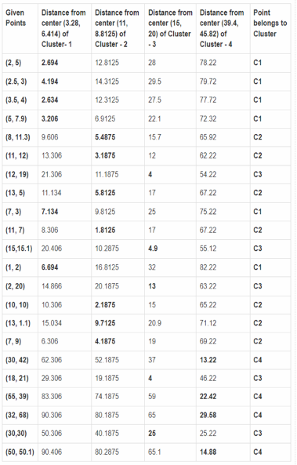
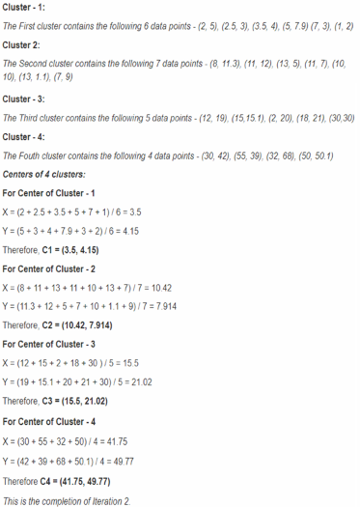
Solution 8 - Iteration 2

Slide 19
Question 9
Suppose we train a model to predict whether an email is Spam or Not Spam. After training the model, we apply it to a test set of 500 new email messages (also labelled) and the model produces the contingency table below.
[A] Compute the precision of this model with respect to the Spam class.
[B] Compute the recall of this model with respect to the Not Spam class.
 |  | True Class
 |  | Spam | Not Spam
Predicted Class | Spam | 70 | 30
 | Not Spam | 70 | 330

Slide 20
Question 9
Suppose we train a model to predict whether an email is Spam or Not Spam. After training the model, we apply it to a test set of 500 new email messages (also labelled) and the model produces the contingency table below.
[A] Compute the precision of this model with respect to the Spam class.
[B] Compute the recall of this model with respect to the Spam class.
 |  | True Class
 |  | Spam | Not Spam
Predicted Class | Spam | 70 | 30
 | Not Spam | 70 | 330
Answer:
[A] Precision with respect to SPAM = # correctly predicted as SPAM / # predicted as SPAM
= 70 / (70+30) = 70%
[B] Recall with respect to SPAM = # correctly predicted as SPAM / # true SPAM
= 70 / (70 + 70) = 50%

Slide 21
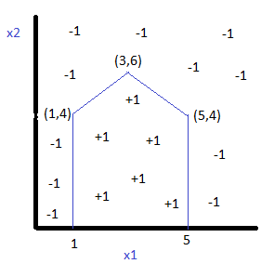
Question 7
The decision boundary for a two-class +1/-1 problem is given below in left. Specify the parameters weights and bias of the perception network on the right that can generate the given decision boundary. Note for a perceptron node, the output is +1 for input greater than or equal to 0, else output is -1.

Slide 22
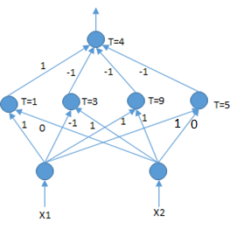
Solution 7
The decision boundary for a two-class +1/-1 problem is given below in left. Specify the parameters weights and bias of the perception network on the right that can generate the given decision boundary. Note for a perceptron node, the output is +1 for input greater than or equal to 0, else output is -1.

Slide 23
Solution 7
The decision boundary consists of the following four straight lines: x1=1, -x1+x2=3, x1+x2=9 and x1=5. The four hidden nodes weights and biases correspond to the coefficients of these four lines, respectively.
Now points labelled as positive class fall on the right side of x1=1, below the lines -x1+x2=3, x1+x2=9 and left side of x1=5. So corresponding weights from hidden nodes to output can be obtained as 1, -1, -1 and -1, respectively.
For points labelled as positive class +, total input to the output node is 4, whereas for points labelled as negative class -, total input to output node is less than 4. So bias at the output node is obtained as 4.

